Slide 1




C#: ASP.NET MVC Overview
Models with Entity Framework, Views with Razor, Controllers
C#
ASP.NET
SoftUni Team
Technical Trainers
Software University
http://softuni.bg

Slide 2


Table of Contents
ASP.NET Overview
ASP.NET Models
Using Entity Framework
Controllers
Handling Forms
GET, POST methods
Authorization
Razor View Engine
Syntax, Variables, Conditions, Loops

Slide 3
Have a Question?
sli.do #tech-softuni

Slide 4

ASP.NET Overview
ASP.NET MVC, Razor, Entity Framework

Slide 5
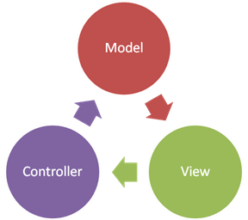
ASP.NET MVC
Open Source Web Application MVC framework
Developed by Microsoft
Code and markup are separated
Based on .NET Framework
Can develop Web Apps using C# and use all of its features
Often combined with Entity Framework for ORM
Can use Razor as a View Engine

Slide 6

Entity Framework
Powerful ORM for ASP.NET MVC

Slide 7

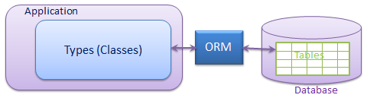
Entity Framework
Object-Relational Mapping (ORM) Framework for C#
Replace DB query access with object functions
Persistence
Change object in-memory ➔ changes it in DB
Add object to collection ➔ add it to DB
High Performance
Lazy-loading
Eager loading by request

Slide 8
C# Attributes
C# uses strongly-typed attributes
Syntax highlighting + error checking
[Attribute] describes the code below it
[Required]
public String Email { get; set; }
Versatile Access Control
[Authorize(Roles = "Administrator")]
public ActionResult АdminPanel()
{
…
}

Slide 9
Entity Framework: Model - Properties
Classic C# Classes with Attributes:
[Id]
public int Id { get; set; }
[Required]
public string Email { get; set; }
public string FullName { get; set; }
public ICollection<Article> Articles { get; set; }
[Required] makes the DB column non-nullable

Slide 10
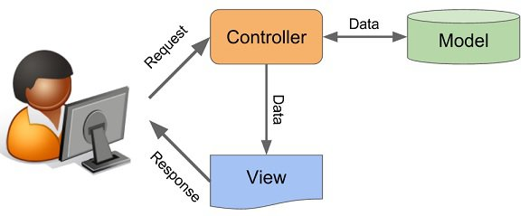
ASP.NET Controllers

Slide 11
ASP.NET Controllers
Controllers can contain multiple actions on different routes.
Route configuration is defined in RouteConfig.cs
Routes are automatically generated, based on RouteConfig
public class ArticleController : Controller
{
public ActionResult List(int Id)
{
...
}
}
Action Parameters
Generated Route: /Article/List/{id}

Slide 12
Controller Actions
Annotated with [Http{method}]
[HttpGet]
public ActionResult Index() {
return View();
}
[HttpPost]
public ActionResult Create()
{
…
}

Slide 13
Processing GET Requests
Create route for a GET request:
Returns the view in Views/{controller}/{action}.cshtml
[HttpGet]
public ActionResult Index()
{
return View();
}

Slide 14
Processing POST Requests
Similar to the [HttpGet] there is also an alias for method POST:
Similar attributes exist for all other types of request methods
[HttpPost]
public ActionResult Register()
{
…
}

Slide 15
Controllers: Database Access
We can access the database, using EF’s DbContext class:
[HttpGet]
public ActionResult ListArticles()
{
using (var db = new BlogDbContext())
{
var articles = db.Articles.ToList();
return View(articles);
}
}

Slide 16
Database Access: Reading Data
We can find a single element by ID, using DbContext.Find()
[HttpGet]
public ActionResult ArticleDetails(int id)
{
using (var db = new BlogDbContext())
{
var article = db.Articles.Find(id);
return View(article);
}
}

Slide 17
Database Access: Reading Data (2)
We can use LINQ on DbContext, just like a normal collection
[HttpGet]
public ActionResult ArticlesByAuthor(int authorId)
{
using (var db = new BlogDbContext())
{
var articlesByAuthor = db.Articles
.Where(a => a.Author.Id == authorId)
.ToList();
return View(articlesByAuthor);
}
}

Slide 18
Database Access: Writing Data
Adding new entry to database:
[HttpPost]
public ActionResult CreateArticle(string title, string content)
{
var article = new Article(title, content);
using (var db = new BlogDbContext())
{
db.articles.Add(article);
db.SaveChanges();
}
return RedirectToAction("Index", "Home");
}

Slide 19
Database Access: Writing Data (2)
Editing existing new entry in database:
[HttpPost]
public ActionResult Edit(int id, string title, string content)
{
using (var db = new BlogDbContext())
{
var article = db.Articles.Find(id);
article.Title = title;
article.Content = content;
db.SaveChanges();
}
return RedirectToAction("Index", "Home");
}

Slide 20
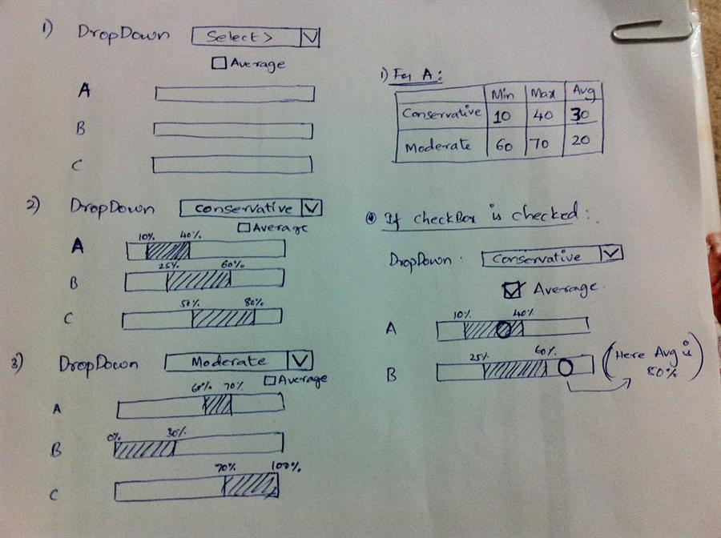
Razor View Engine

Slide 21
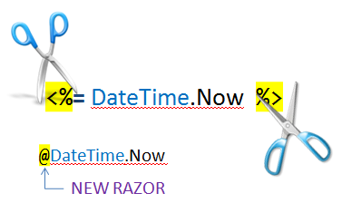
Razor View Engine
Template markup syntax
Simple-syntax view engine
Based on the C# programming language
Enables the programmer to use an HTML construction workflow
Code-focused templating approach, with minimal transition between HTML and code
Razor syntax starts code blocks with a @ character and does not require explicit closing of the code-block

Slide 22
Razor View Engine: Possibilities
Razor allows us to:
Use variables/collections in our views
Execute operations on variables
Iterate over collections
Expressions – DateTime.Now, etc.
Dynamically generate HTML, using ASP.NET HTML helpers

Slide 23
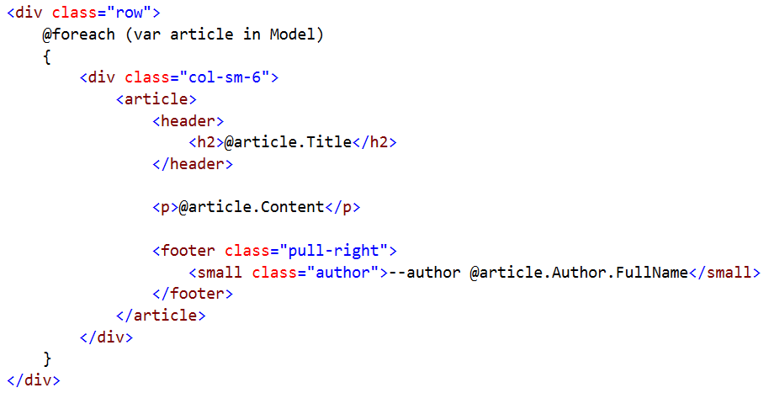
Razor View Engine: Example
HTML mixed with C# code (@ switches to C#):
C# foreach
HTML
Syntax
C# code
C# code
C# code

Slide 24

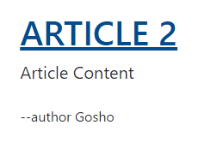
HTML Helpers: Example
HTML Controller Action Link
@Html.ActionLink(
article.Title,
"Details",
"Article",
new {
id = article.Id
},
new {
@class = "text-uppercase"
}
)
Link text
Action
Controller
Controller Route Values
HTML Attributes

Slide 25


Summary
Building robust web applications with C#, using ASP.NET
Open Source Web MVC Framework for C#
Controller handling, attributes, authorization
Entity Framework
ORM framework for C#
Takes care of Persistence and Transactions
Razor View Engine
Variables, Iteration, Conditional statements

Slide 26
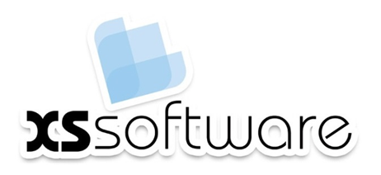







C#: ASP.NET Overview
https://softuni.bg/courses/software-technologies

Slide 27
License
This course (slides, examples, demos, videos, homework, etc.) is licensed under the "Creative Commons Attribution-NonCommercial-ShareAlike 4.0 International" license

Slide 28





Trainings @ Software University
Software University Foundation – softuni.org
Software University – High-Quality Education, Profession and Job for Software Developers
softuni.bg
Software University @ Facebook
facebook.com/SoftwareUniversity
Software University Forums – forum.softuni.bg

